Slide 1

Capstone Project
Marketing and Retail Analytics
§Presented By :
1. Chetan R Tippa
2. Sphurti Gaikwad
3. Vaishnavi Pande

Slide 2

AGENDA
1.Background
2.Objective
3.Data methodology
4.Data visualization & Market basket analysis
5.Dashboard
6.Insights
7.Recommendation
1/27/2023
2

Slide 3

1. BACKGROUND
• OList is one such e-commerce company that has faced some losses
recently and they want to manage their inventory very well so as to
reduce any unnecessary costs that they might be bearing. In this
assignment, we have to manage the inventory cost of this e-commerce
company OList.
1/27/2023
3

Slide 4

2. OBJECTIVE
• OList is one such e-commerce company that has recently suffered losses
and wishes to better manage their inventory in order to reduce any
unnecessary costs.
a. We need to identify top products that contribute to the company’s
revenue.
b. Use the market basket analysis to analyze the purchase behavior of
individual customers to estimate with relative certainty.
c. Find out what items are more likely to be purchased individually or in
combination with some other products.
1/27/2023
4

Slide 5

3. DATA METHODOLOGY
Ø Perform EDA on dataset
Before drawing any conclusions from the dataset, treat the outliers and
missing values carefully.
ØData exploration and cleaning
Identify duplicate and missing values in each column and deal with them
accordingly and treat all data quality issues related to provided dataset.
1/27/2023
5

Slide 6

Ø EDA IN BRIEF :
1. We started with consideration of cases which are having order status
as “delivered” & then for further analysis imported all the required
libraries and checked the size of the provided dataset.
2. We then checked for duplicate values for both the fields i.e.
“Order_id” & “Customer_id”.
3. Further we found that there are missing values in the dataset. To treat
this instead dropping the records we replaced it with the other fields.
a. Replaced “order_approved_at” with “order_purchase_timestamp”.
b. Replaced “order_delivered_timestamp” with
“order_estimated_delivery_date”.
2/5/2023
6

Slide 7
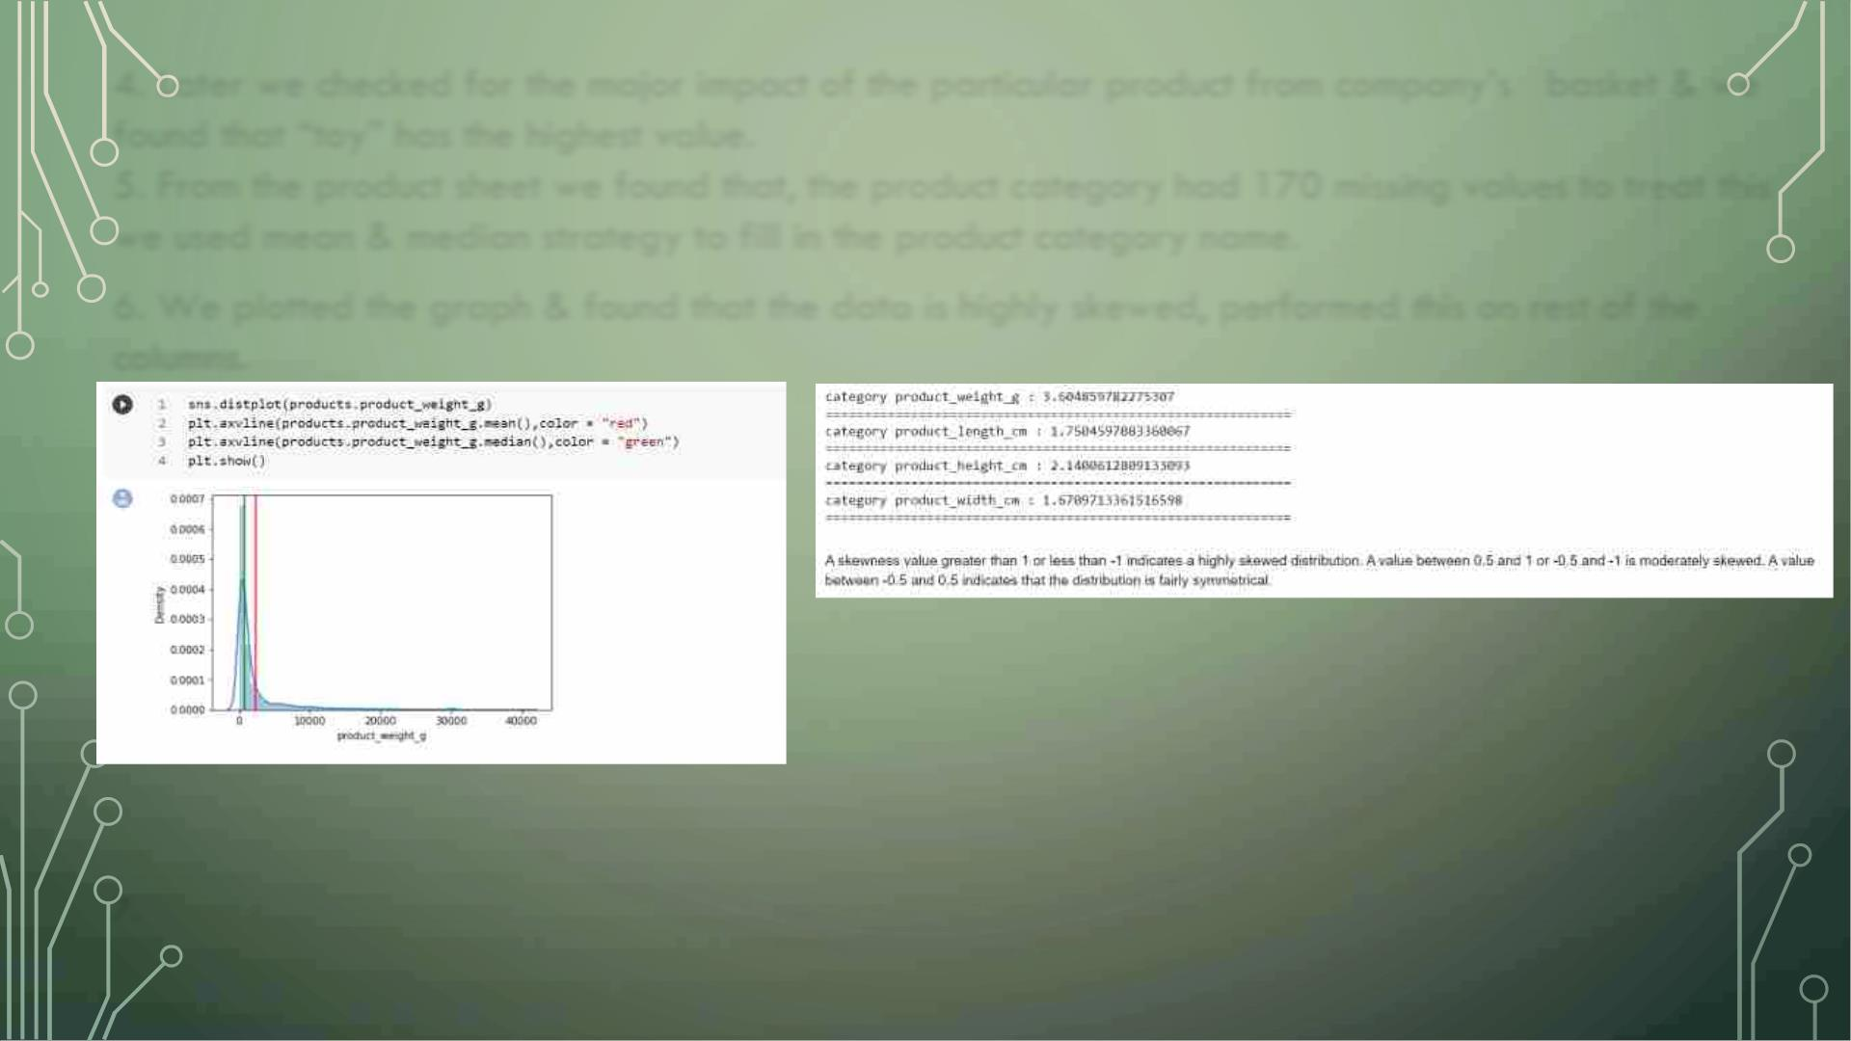
4. Later we checked for the major impact of the particular product from company’s basket & we
found that “toy” has the highest value.
5. From the product sheet we found that, the product category had 170 missing values to treat this
we used mean & median strategy to fill in the product category name.
6. We plotted the graph & found that the data is highly skewed, performed this on rest of the
columns.
7. Cleaned dataset converted to excel for Tableau analysis.
2/5/2023
7

Slide 8

4. Data visualization & Market basket analysis
Ø Data visualization:
•Create appropriate visualizations to identify the
most ordered products by quantity and revenue.
•The percentage running totals by revenue and
number of orders are depicted correctly for each
product.
1/27/2023
8

Slide 9
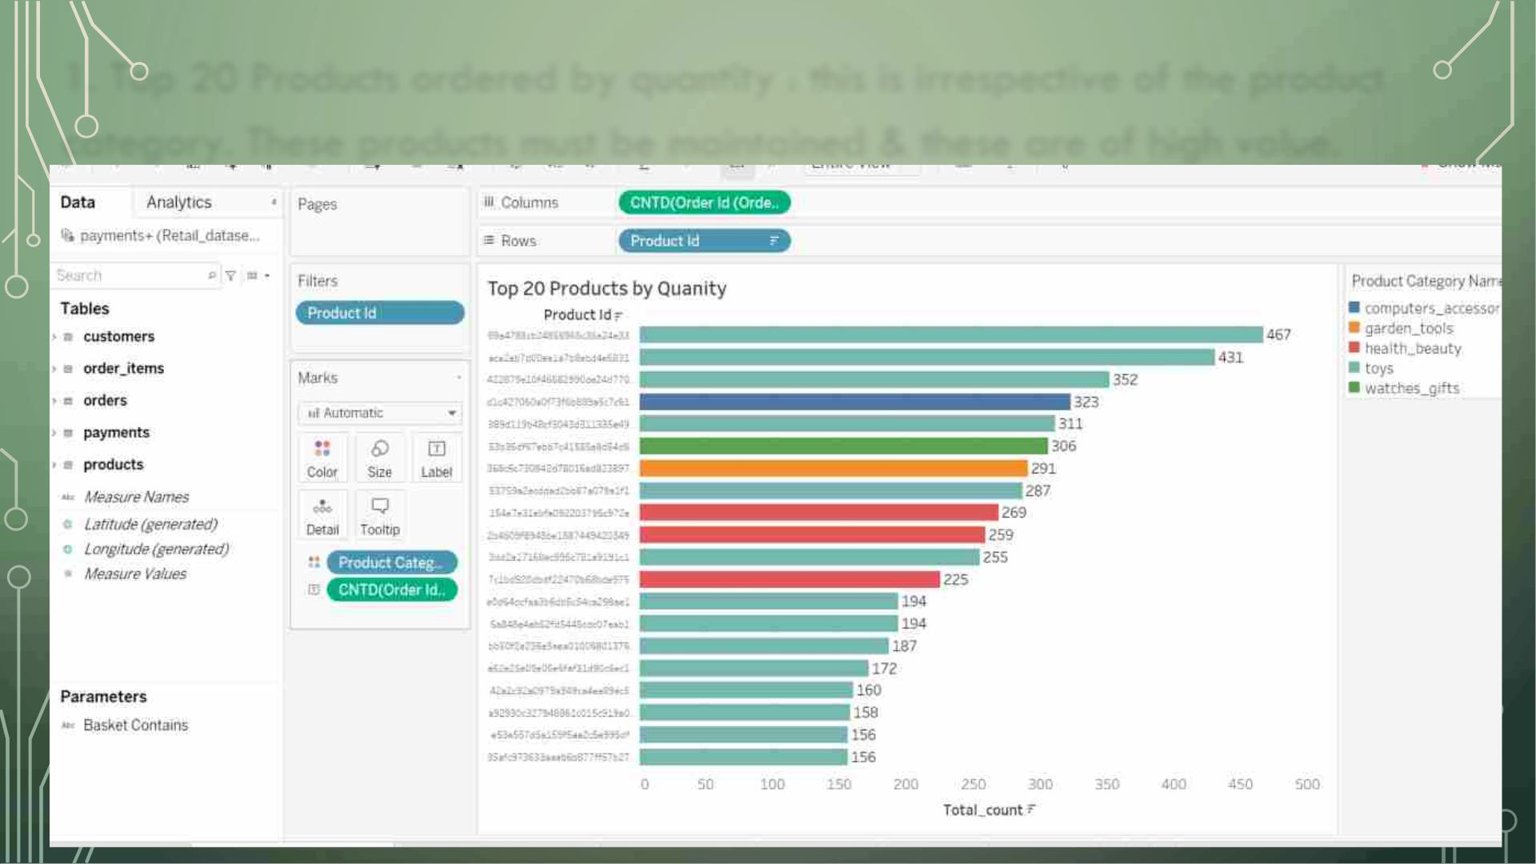
1. Top 20 Products ordered by quantity : this is irrespective of the product
category. These products must be maintained & these are of high value.

Slide 10
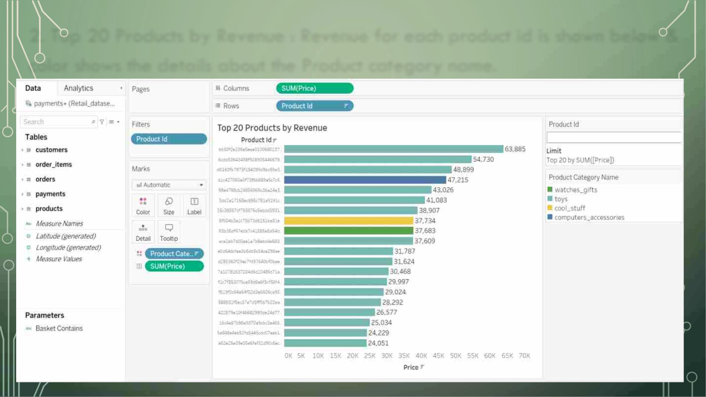
2. Top 20 Products by Revenue : Revenue for each product id is shown below &
color shows the details about the Product category name.

Slide 11
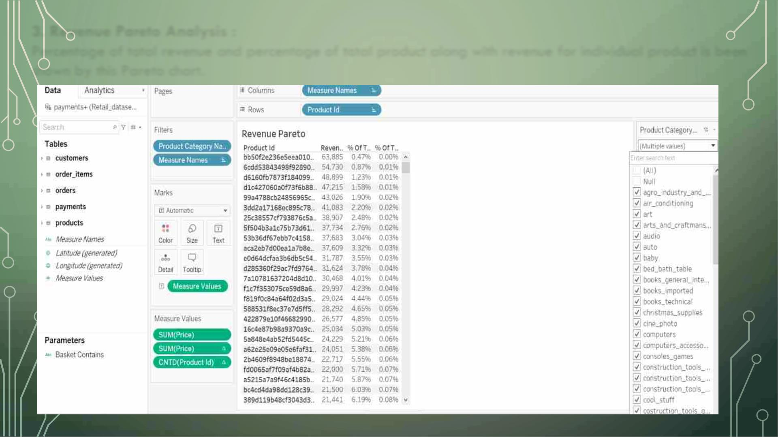
3. Revenue Pareto Analysis :
Percentage of total revenue and percentage of total product along with revenue for individual product is been
shown by this Pareto chart.
11

Slide 12
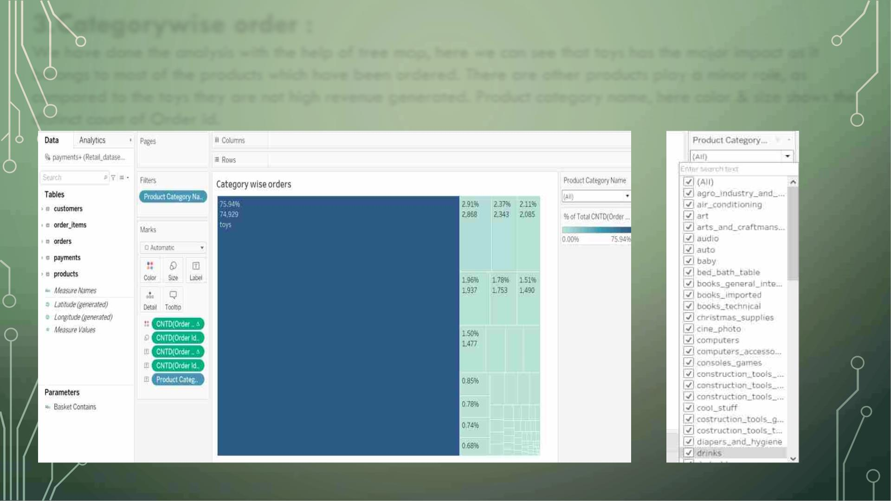
3.Categorywise order :
We have done the analysis with the help of tree map, here we can see that toys has the major impact as it
belongs to most of the products which have been ordered. There are other products play a minor role, as
compared to the toys they are not high revenue generated. Product category name, here color & size shows the
distinct count of Order id.
2/5/2023
12

Slide 13

ØMarket basket analysis:
Identify combinations of product categories that are ordered
frequently and visualize them as required. This can be done by
creating a simple matrix with product categories in the rows and
columns and then checking which of the pairs show associations.
2/5/2023
13

Slide 14
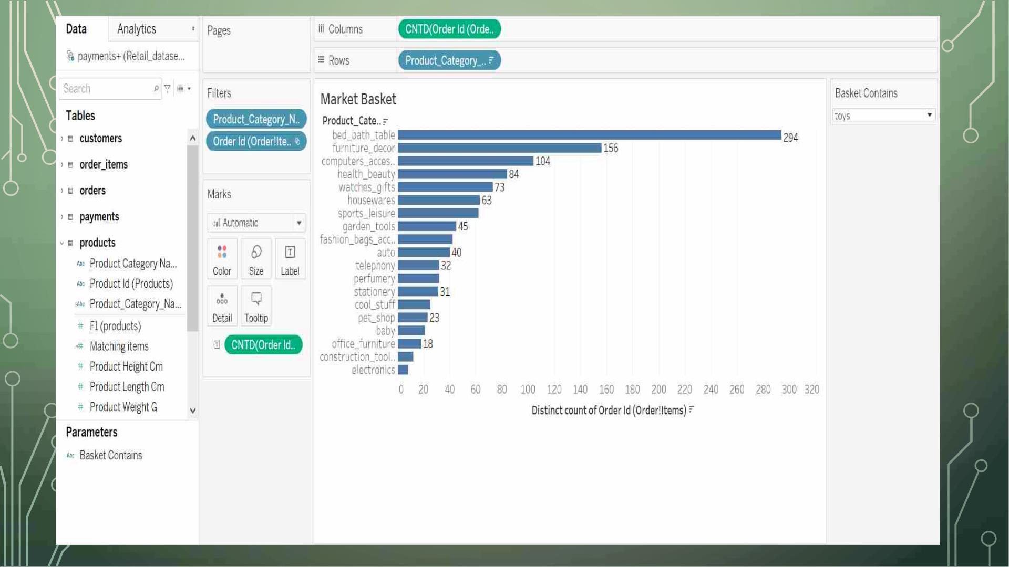
2/5/2023
14

Slide 15

•Conclusion :
After combining the data, we found that "bed bath
table" and "toys" has the highest distinct count of
orders which is 294.
2/5/2023
15

Slide 16
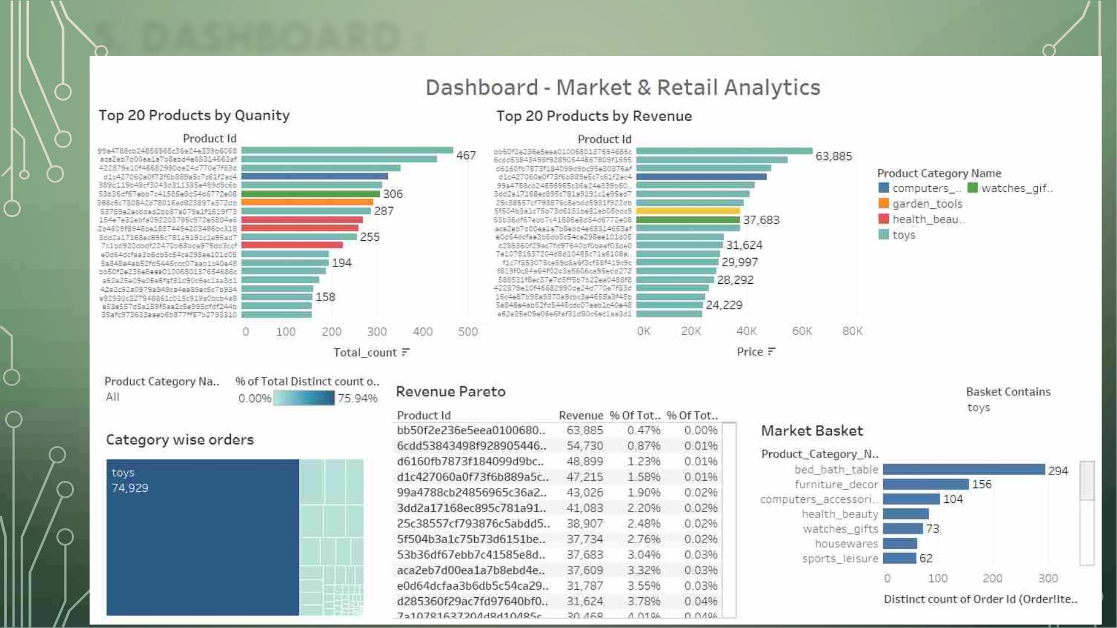
5. DASHBOARD :

Slide 17

6. INSIGHTS
v The category “Toys” constitutes 20% of the products, generating 80% of
the revenue.
vThe category” Toys” is the most ordered product category by quantity.
v Toys and bed bath table are the most frequently bought Product
category. Next is Toys with Furniture Décor which are more frequently
bought.
v Hence the combination of al of these few categories with the toys & each
other products are frequently ordered.
2/5/2023
17

Slide 18

7. RECOMMENDATION :
1. To attract more customers, make some good
offers and discounts.
2. Customers who make frequent purchases
should be given special offers and benefits like
combo offers.
3. Target Customers who have newborns since
they are likely to buy bed bath table along
with Toys.
2/5/2023
18

Slide 19


